Slide 1
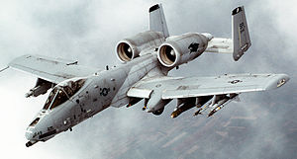

in-flight to insights: directors cut
Real-time insights with Event Hubs, Stream Analytics, Power BI and an A10 Warthog
Adam Finster
Architect
BCM Solutions
Todd Whitehead
Cloud Solution Architect
Microsoft
Michael “Loophole” Barnes
A-10 Pilot
62nd Fighting Falcons

Slide 2
Disclaimer
Whilst I am employee of Microsoft, the views, opinions and lame jokes that I may or may not present tonight are my own and in no way represent those of Microsoft or in fact any person living or dead beginning with the letter M.

Slide 3

Objectives
Objectives (technical)
Architect IoT solutions using Azure
Build a IoT simulator
Simulate complex environment using gaming
Objectives (more importantly)
Learn some Azure outside the usual stack
Showcase IoT in a non-trivial way
Find a legitimate (and tax deductible) reason to play games
Adam

Slide 4

Agenda
Objectives (aka Talk to me Goose)
IoT in 180 seconds (aka I feel the need!)
End to End Demo (aka Come on, Mav, do some of that pilot sh**!")
Peeling the demo apart (aka Goooooose! Too soon?)
Other Options (aka You don't own these planes son the tax payers do)
What’s Next Now (aka Inverted dive with a Mig-28)

Slide 5
What is the Internet of Things (IoT)?
Things
Connectivity
Data
Analytics

Slide 6
IoT 2010
Alarm clock
Refrigerator
Automobile
VoIP phone
Computer
Printer
Media player
Microwave
HOME
WORKPLACE
HOME
Coffee maker
Smart scale
Oven
Cell phone
HVAC
Vending
Security
Television

Slide 7
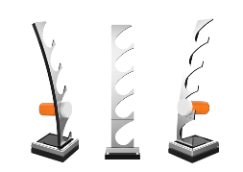
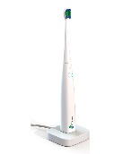

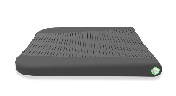
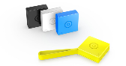



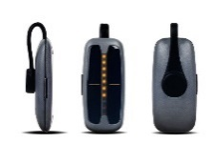
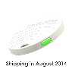
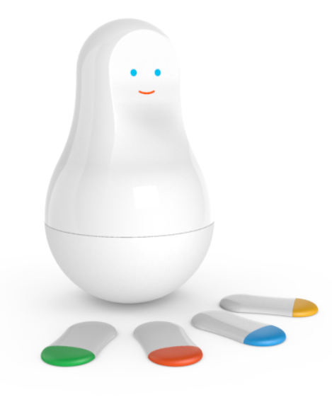
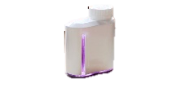

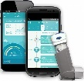


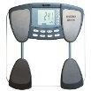
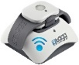
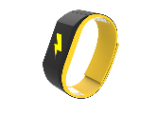
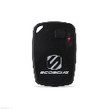


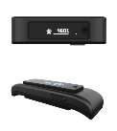


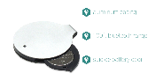
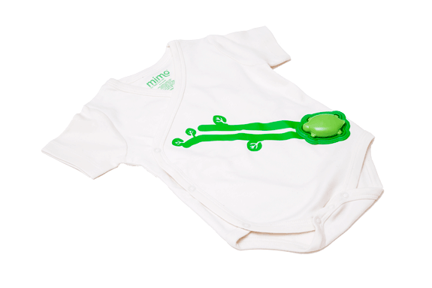
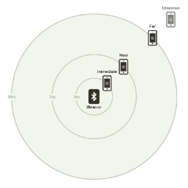
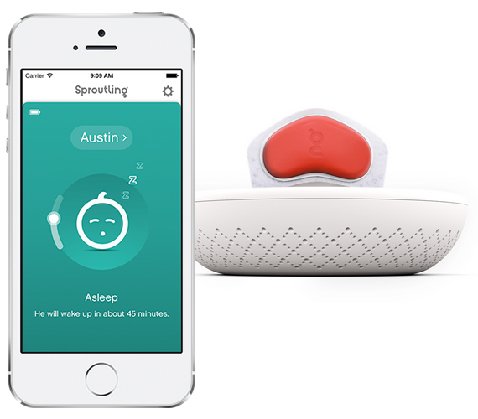


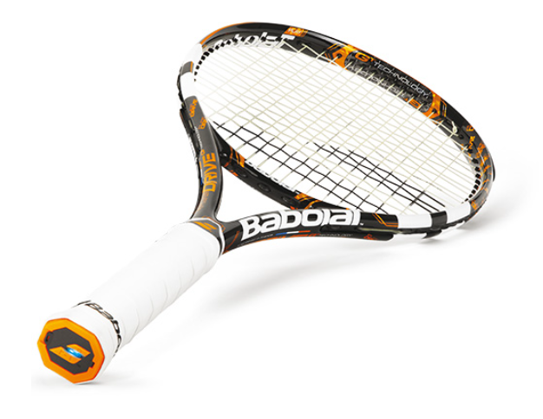
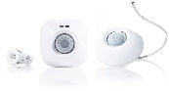
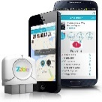
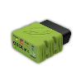

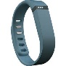
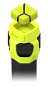
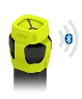
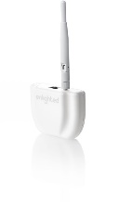
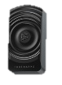

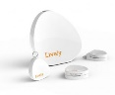
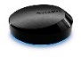
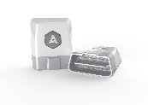
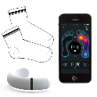
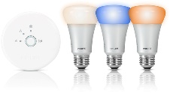
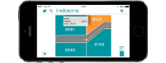

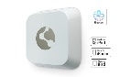
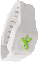
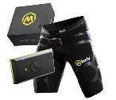



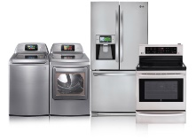
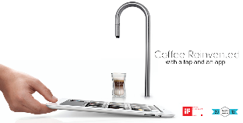
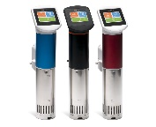
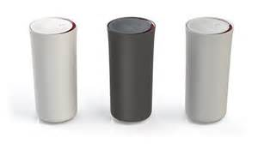
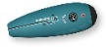
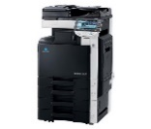
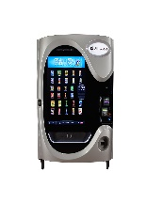
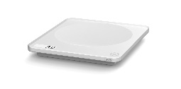
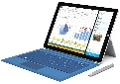
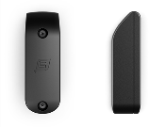
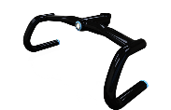
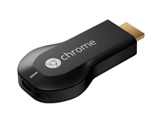
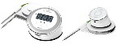



































IoT 2015
Medication adherence
Health monitoring
Pet tracking
Behavior modification
Object tracking
Child and elder monitoring
Sports and fitness
Indoor navigation
Trip tracking and car health
Smart lighting
Beacons and proximity
COMMUTE
COMMUTE
HOME
WORKPLACE
HOME
Smart appliances
Food and nutrition tracking
Identity
Office equipment
Smart vending machines
Bike ride stats and protection
Air conditioning and temperature control
Sleep tracking
Environmental sensors
Information capture
Control
Home security
Home automation
Leak detection
Garden, lawn and plant care
New devices and sensors
Entertainment systems

Slide 8


Internet of Cows (IoC)
https://www.youtube.com/watch?v=oY0mxwySaSo
Notes:
Improves calf production up to 31%, with an average of 12%
Modernizes data access with mobile phone alerts, reducing labor costs for monitoring cows
Transforms herd management by allowing farmers to increase chances of producing a male or female calf
Reduces loss by detecting 8-10 different kinds of diseases in cattle

Slide 9



IoTHW (Internet of Things Hello World)

Slide 10
Simulating IoT Systems
Too Complex to Build Real Devices
Devices are expensive
Devices are complex
Devices may not exist
Unable to Test all Scenarios
Test edge cases
Test alert cases
Test command and control
Unable to Scale
Scale to entire production and future levels
Scale for large number of distributed developers

Slide 11

Simulators be Simulating
Notes:
Adam Takes Over
Simulating a complex world not just an aircraft
Talk about the different sort of units (vehicles, aircraft, troops)
Each vehicle, person and munition is send telemetry data
Talk about the data collector of doom and what it is doing

Slide 12






Demo Architecture
Event Producers
Ingestion
Transformation
Long Term Storage
Presentation & Action
Data collector of doom
Event Hub
Stream Analytics
Blob
Power BI
SQL
Notes:
Explain the basic architecture of what we are going to demo
SQL will provide reference data
Blob storage will provide long term storage
Power BI for visualization

Slide 13

Demo

Slide 14





IoT Device & Cloud Patterns
Batch Analytics & Visualizations
Azure HDInsight, AzureML, Power BI,
Azure Data Factory
Cloud Gateway
Event Hub
Hot Path Analytics
Azure Stream Analytics, Azure Storm
Presentation & Business Connections
Websites, Mobile Services
Dynamics, BizTalk Services, Notification Hubs
Protocol Adaptation
Hot Path Business Logic
Service Fabric & Actor Framework
Devices
RTOS, Linux, Android, iOS, Windows
Field Gateway
Device
Connectivity & Management
Analytics &
Operationalized Insights
Presentation &
Business Connectivity

Slide 15













Azure Streaming/IoT services (When we started)
Devices | Device Connectivity | Storage | Analytics | Presentation & Action
 | Event Hubs | SQL Database | Machine Learning | App Service
 | Service Bus | Table/Blob Storage | Stream Analytics | Power BI
 | External Data Sources | DocumentDB | HDInsight | Notification Hubs
 |  | External Data Sources | Data Factory | Mobile Services
 |  |  |  | BizTalk Services
{ }

Slide 16

Event Hubs: Role
Event Hub
Cloud-scale telemetry ingestion from websites, apps, and devices
Compatible with more than a million publishers supporting HTTP, AMQP and MQTT
Ingress millions of events per second
Configurable data retention (1-30 days)
Low latency (<10 ms for volatile data)
Pluggable with other cloud services like Stream Analytics
Notes:
Microsoft Azure Service Bus Event Hubs is an event ingestor service that provides event and telemetry ingress to the cloud at massive scale, with low latency and high reliability.
This service, used with other downstream services, is particularly useful in application instrumentation, user experience or workflow processing, and Internet of Things (IoT) scenarios.

Slide 17

Event Hubs: Key concepts
Notes:
Event Hubs provides a message stream handling capability and though an Event Hub is an entity similar to queues and topics, it has very different characteristics than traditional enterprise messaging. Enterprise messaging scenarios commonly require a number of sophisticated capabilities such as sequencing, dead-lettering, transaction support, and strong delivery assurances, while the dominant concern for event ingestion is high throughput and processing flexibility for event streams. Therefore, the Azure Event Hubs capability differs from Service Bus topics in that it is strongly biased towards high throughput and event processing scenarios. As such, Event Hubs does not implement some of the messaging capabilities that are available for topics. If you need those capabilities, topics remain the optimal choice.
An Event Hub is created at the namespace level in Service Bus, similar to queues and topics. Event Hubs uses AMQP and HTTP as its primary API interfaces.
Event Hubs provides message streaming through a partitioned consumer pattern. Queues and topics use a Competing Consumer model in which each consumer attempts to read from the same queue or resource. This competition for the resource ultimately results in complexity and scale limits for stream processing applications. Event Hubs uses a partitioned consumer pattern in which each consumer only reads a specific subset, or partition, of the message stream. This pattern enables tremendous horizontal scale for event processing and provides other stream-focused features that are unavailable in queues and topics.

Slide 18


Event Hubs: Partitions
Notes:
Partitions retain data for a configured retention time that is set at the Event Hub level and applies across all partitions in the Event Hub. Events expire on a time basis; you cannot explicitly delete them. An Event Hub contains multiple partitions. Each partition is independent and contains its own sequence of data. As a result, partitions often grow at different rates.
The number of partitions is specified at the Event Hub creation time and must be between eight and 32.
The number of partitions is primarily influenced by the degree of downstream parallelism required in consuming applications. Partitions are a data organization mechanism and are more related to downstream parallelism than to Event Hub throughput. This makes the choice of number of partitions in an Event Hub directly related to the number of concurrent readers you expect to have.
After Event Hub creation, the partition count is not changeable so you should consider this number in terms of long-term expected parallelism. You can increase the 32 partition limit by contacting the Microsoft Azure Service Bus team.

Slide 19
Demo: Event Hub
Data collector of doom
Event Hub
Stream Analytics
Power BI
Acquire SAS
Establish Connection
Publish Events
Create Event Hub
Set Policies
Monitor
Notes:
Acquiring a SAS Token
Shared Access Signature (SAS) is the authentication mechanism for Event Hubs. Service Bus provides SAS policies at the namespace and Event Hubs level. A SAS token is generated from a SAS key and is an SHA hash of a URL encoded in a specific format. Using the name of the key (policy) and the token, Service Bus can regenerate the hash and thus authenticate the sender. Normally, SAS tokens for event publishers are created with only send privileges on a specific Event Hub. This SAS token URL mechanism is the basis for publisher identification introduced in the Publisher Policy. For more information about working with SAS, see Shared Access Signature Authentication with Service Bus.
Publishing an Event
You can publish an event via AMQP 1.0 or HTTPS. Service Bus provides an EventHubClient class that you can use for publishing events to an Event Hub from .NET clients. For other runtimes and platforms, you can use any AMQP 1.0 client such as Apache Qpid.
You can publish events individually, or batched.
A single publication (event data instance) has a limit of 256KB, regardless of whether it is a single event or a batch. Publishing events larger than this will result in an error. It is a best practice for publishers to be unaware of partitions within the Event Hub and to only specify a PartitionKey, introduced below, or their identity via their SAS token.
The choice to use AMQP or HTTPS is specific to the usage scenario. AMQP requires the establishment of a persistent bidirectional socket in addition to transport level security (TLS) or SSL/TLS. This can be a costly operation in terms of network traffic, but only hap

Slide 20

Event Hub: Pricing
Notes:
2 components to pricing
Events
Throughput units
What are throughput units and how are they billed?Throughput units are explicitly selected by the customer, either through the Azure portal or Event Hub management APIs. Throughput units apply to all Event Hubs in a Service Bus namespace, and each throughput unit entitles the namespace to the following capabilities:
Up to 1 MB per second of ingress events (= events send into an Event Hub), but no more than 1000 ingress events, management operations, or control API calls per second.
Up to 2 MB per second of egress events (= events consumed from an Event Hub).
Up to 84GB of event storage (sufficient for the default 24 hour retention period).
Throughput units are billed hourly, based on the maximum number of units selected during this hour.
How are Event Hub throughput units enforced?If the total ingress throughput or the total ingress event rate across all Event Hubs in a namespace exceeds the aggregate throughput unit allowances, senders will get throttled and receive errors indicating that the ingress quota has been exceeded.
If the total egress throughput or the total event egress rate across all Event Hubs in a namespace exceeds the aggregate throughput unit allowances, receivers will get throttled and receive errors indicating that the egress quota has been exceeded. Ingress and egress quotas are enforced separately, so that no sender can cause event consumption to slow down, nor a receiver can prevent events from being sent into Event Hub.
Note that the throughput unit selection is independent of the number of Event Hub Partitions (sometimes referred to as shards in similar systems). While each Partition offers a maximum throughput of 1 MB per second 1000 event per second ingress, and 2 MB per second egress, there is no fixed charge for the partitions themselves. The charge is for the aggregate throughput units on all Event Hubs in a Service Bus namespace. With this, customers can create enough Partitions to support the anticipated maximum load for their systems, without incurring any Throughput Unit charges until the Event load on the system actually requires higher throughput numbers, and without having to change the structure and architecture of their systems as the load on the system increases.
Example: Suppose you chose 8 throughput unit on a namespace, and create a single Event Hub with 32 partitions. If all partitions in this Event Hub see even load, each partition gets approximately 0.25 MB/s ingress throughput for a total aggregate throughput of 8 MB/s. If a single partition sees a usage spike to 1 MB/s, while 8 other partitions only see half their peak load (0.125 MB/s), no throttling will occur. However, if the single partition spiked beyond 1 MB/s, it will get throttled due to the per-partition limit, even if the aggregate throughput of all partitions is below the 8 MB/s.

Slide 21
Stream Analytics
Stream Analytics
From events or data streams to insights in less time and effort
Real-time analytics for Internet of Things solutions
Stream millions of events per second
Mission critical reliability, performance and predictable results
Rapid development with familiar SQL-based language

Slide 22


What is Streaming Data?
Data at Rest
Data in Motion

Slide 23
Events and Time
Every event that flows through the system has a timestamp
User can pick it from the payload
SELECT * FROM TwitterStream TIMESTAMP BY CreatedAt
Or the system can assign timestamps automatically based on the event arrival time
SELECT * FROM TwitterStream
Projecting timestamp into payload
SELECT System.Timestamp AS Time, Text FROM TwitterStream
Note: System.Timestamp is a reserved property that exposes the timestamp of an event.

Slide 24
Tumbling Windows
Tell me the count of tweets per time zone every 10 seconds
A 10-second Tumbling Window
1
5
4
6
2
8
6
5
3
6
1
0
5
10
15
20
25
30
Time
(secs)
1
5
4
6
2
8
6
5
3
6
1
SELECT TimeZone, COUNT(*) AS Count
FROM TwitterStream TIMESTAMP BY CreatedAt
GROUP BY TimeZone, TumblingWindow(second,10)

Slide 25
Hopping Windows
A 10-second Hopping Window with a 5-second “Hop”
Every 5 seconds give me the count of tweets and the average sentiment score over the last 10 seconds
1
5
4
6
2
8
7
5
3
6
1
0
5
10
15
20
25
30
Time
(secs)
1
5
4
6
2
4
6
2
8
6
8
6
5
3
5
3
6
1
SELECT Topic, COUNT(*) AS TotalTweets, AVG(SentimentScore)
FROM TwitterStream TIMESTAMP BY CreatedAt
GROUP BY Topic, HoppingWindow(second, 10 , 5)

Slide 26
Sliding Windows
A 10-second Sliding Window
1
5
9
8
Give me the count of tweets for all topics which are tweeted more than 10 times in the last 10 seconds
0
5
10
15
20
25
Time
(secs)
1
1
5
1
5
9
8
SELECT Topic, COUNT(*) FROM TwitterStream
TIMESTAMP BY CreatedAt
GROUP BY Topic, SlidingWindow(second, 10)
HAVING COUNT(*) > 10

Slide 27
Joining multiple streams
List all users and the topics on which they switched their sentiment within a minute
Twitter Stream:
{“XO”, 4, “Ebola”}
{“Dip”, 2, “XBox”}
{“Jo”, 0, “ALS”}
{“Foo”,4, “ALS”}
Twitter Stream:
{“XO”, 0, “Ebola”}
{“Jo”, 4, “ALS”}
{“Dip”, 0, “Xbox”}
{“Foo”, 0, “ALS”}
time
SELECT TS1.UserName, TS1.Topic
FROM TwitterStream TS1 TIMESTAMP BY CreatedAt
JOIN TwitterStream TS2 TIMESTAMP BY CreatedAt
ON TS1.UserName = TS2.UserName AND TS1.Topic = TS2.Topic AND DATEDIFF(second, TS1, TS2) BETWEEN 1 AND 60
WHERE TS1.SentimentScore != TS2.SentimentScore

Slide 28

Reference Data
Seamless correlation of event streams with reference data
Static or slowly-changing data
Same programming experience:
SELECT myRefData.Name, myStream.Value
FROM myStream JOIN myRefData
ON myStream.myKey = myRefData.myKey

Slide 29
Demo continued
Data collector of doom
Event Hub
Stream Analytics
Power BI
Create Consumer Group
Create Consumer Group

Slide 30
SAQL – Language & Library
DML
SELECT
FROM
WHERE
GROUP BY
HAVING
CASE WHEN THEN ELSE
INNER/LEFT OUTER JOIN
UNION
CROSS/OUTER APPLY
CAST
INTO
ORDER BY ASC, DSC
Date and Time Functions
DateName
DatePart
Day
Month
Year
DateTimeFromParts
DateDiff
DateAdd
Aggregate Functions
Sum
Count
Avg
Min
Max
StDev
StDevP
Var
VarP
Temporal Functions
Lag, IsFirst
CollectTop
String Functions
Len
Concat
CharIndex
Substring
PatIndex
Scaling Extensions
WITH
PARTITION BY
OVER
Windowing Extensions
TumblingWindow
HoppingWindow
SlidingWindow

Slide 31
Son, your ego is writing checks your body can't cash
Daily Azure Stream Analytics cost for 1 MB/sec of average processing
Volume of Data Processed Cost -
$0.001 /GB * 84.375 GB = $0.08 per day, streaming max 1 MB/s non-stop
Streaming Unit Cost -
$.031 /hr * 24 hrs = $0.74 per day, for 1 MB/sec max. throughput
Total cost -
$0.74 + $0.08 = $0.82 per day -or- ~ $25 per month

Slide 32







Other Options:
Aka You don't own these planes son the tax payers do.
https://github.com/PaulStubbs/AzureSmartCitySimulator
Notes:
City Simulation Game
Windows, OSX, Linux
Easy to extend using C# (Mono)
Easy to get and demo (Steam)
Huge modding community
Mod’s source code available

Slide 33

Coming Soon: Azure IoT Suite/Hub
IoT Hub
Bi-directional device <-> cloud
Up to 10 million devices
Telemetry ingestion
Command & control
Device registry & identity
Device Management
HTTP/AMQP
Extensible protocol support / MQTT
Pre-Built Scenarios
Remote monitoring
Asset management
Predictive maintenance
Simplified & predictable billing

Slide 34
Connect your devices to Azure IoT Suite
Azure IoT Suite
IoT Hub
Event processing and insight
(e.g. Azure Stream Analytics)
IP-capable
Cloud protocol
gateway
Field gateway
Application
device runtime logic
PAN-devices
Application
device provisioning and management
field
cloud

Slide 35

Demo: IoT Suite
http://www.azureiotsuite.com/
Notes:
Acquiring a SAS Token
Shared Access Signature (SAS) is the authentication mechanism for Event Hubs. Service Bus provides SAS policies at the namespace and Event Hubs level. A SAS token is generated from a SAS key and is an SHA hash of a URL encoded in a specific format. Using the name of the key (policy) and the token, Service Bus can regenerate the hash and thus authenticate the sender. Normally, SAS tokens for event publishers are created with only send privileges on a specific Event Hub. This SAS token URL mechanism is the basis for publisher identification introduced in the Publisher Policy. For more information about working with SAS, see Shared Access Signature Authentication with Service Bus.
Publishing an Event
You can publish an event via AMQP 1.0 or HTTPS. Service Bus provides an EventHubClient class that you can use for publishing events to an Event Hub from .NET clients. For other runtimes and platforms, you can use any AMQP 1.0 client such as Apache Qpid.
You can publish events individually, or batched.
A single publication (event data instance) has a limit of 256KB, regardless of whether it is a single event or a batch. Publishing events larger than this will result in an error. It is a best practice for publishers to be unaware of partitions within the Event Hub and to only specify a PartitionKey, introduced below, or their identity via their SAS token.
The choice to use AMQP or HTTPS is specific to the usage scenario. AMQP requires the establishment of a persistent bidirectional socket in addition to transport level security (TLS) or SSL/TLS. This can be a costly operation in terms of network traffic, but only hap

Slide 36
Many aspects of connectivity
Functionality
Device-to-cloud telemetry,
Cloud-to-device commands and notifications,
Bulk uploads/downloads
Security
Device security,
Cloud security,
Channel security, …
Monitoring
Identify malfunctioning devices when they cannot be reached directly
Reach and customization
RTOS/Linux/Windows/non-IP capable,
Network/application protocols,
Authentication schemes
Azure IoT Suite
IoT Hub
Cloud protocol
gateways
…
Field gateways

Slide 37
Azure IoT Suite: IoT Hub
Designed for IoT
Connect millions of devices to a partitioned application back-end
Service assisted communications
Devices are not servers
Use IoT Hub to enable secure bi-directional comms
Cloud-scale messaging
Device-to-cloud and Cloud-to-device
Durable messages (at least once semantics)
Cloud-facing feedback
Delivery receipts, expired messages
Device communication errors
Per-device authentication
Individual device identities and credentials
Connection multiplexing
Single device-cloud connection for all communications (C2D, D2C)
Multi-protocol
Natively supports AMQP, HTTP
Designed for extensibility to custom protocols
Multi-platform
Device SDKs available for multiple platforms (e.g. RTOS, Linux, Windows)
Multi-platform Service SDK.

Slide 38
IoT Hub endpoints
Azure IoT Suite
IoT Hub
Event processing
device
Device id
D2C receive endpoint
D2C send endpoint
Device runtime logic
C2D queue
endpoint
C2D send endpoint
Field GW
/
Cloud GW
Msg feedback and monitoring endpoint
Device …
Device …
Device provisioning and management
Device identity management
Device …
IoT Hub management

Slide 39


Announcing!
Windows 10 IoT Core preview available for Minnowboard Max and Raspberry Pi 2
www.windowsondevices.com

Slide 40



















































Platform Services
Security & Management
Compute
Web and Mobile
Developer Services
Hybrid
Operations
Cloud
Services
Service
Fabric
Web Apps
API
Apps
API
Management
Visual Studio
Azure SDK
Portal
Azure AD
Connect Health
Batch
Remote App
Mobile
Apps
Logic
Apps
Notification
Hubs
Team Project
Application
Insights
Active
Directory
AD Privileged
Identity
Management
Multi-Factor
Authentication
Integration
Analytics & IoT
Data
Backup
Storage
Queues
Biztalk
Services
Automation
HDInsight
Machine
Learning
SQL
Database
SQL Data
Warehouse
Operational
Insights
Hybrid
Connections
Service
Bus
Key Vault
Data
Factory
Event
Hubs
Redis
Cache
Search
Import/Export
Store /
Marketplace
Media & CDN
Site
Recovery
Stream
Analytics
Mobile
Engagement
DocumentDB
Tables
VM Image Gallery
& VM Depot
Media
Services
Content Delivery
Network (CDN)
StorSimple
Infrastructure Services
Compute
Storage
Networking
Virtual Machines
Containers
BLOB Storage
Azure Files
Premium Storage
Virtual Network
Load Balancer
DNS
Express
Route
Traffic Manager
VPN Gateway
Application Gateway
Datacenter Infrastructure (24 Regions, 19 Online)

Slide 41
Useful Resources
Microsoft IoT http://www.microsoft.com/en-us/server-cloud/internet-of-things.aspx
IoT Overview https://channel9.msdn.com/events/Build/2015/2-652
Stream Analytics http://azure.microsoft.com/en-us/services/stream-analytics/
Event Hubs http://azure.microsoft.com/en-us/documentation/articles/service-bus-event-hubs-csharp-ephcs-getstarted/
Sims http://www.digitalcombatsimulator.com/en/products/world/
http://www.citiesskylines.com
http://www.steampowered.com
GitHub Repos:
https://github.com/mspnp/iot-journey
https://github.com/toddwhitehead/AzureBattlefieldSimulator
https://github.com/Azure/azure-stream-analytics
https://github.com/PaulStubbs/AzureSmartCitySimulator

Slide 42


62nd Fighting Falcons www.62ndff.com
The 62nd Fighting Falcons is a club created by air combat simulation enthusiasts. Based in Brisbane, the 62nd Fighting Falcons has been operating since 1994, and provides a way for air combat enthusiasts to achieve the ultimate simulation experience - flying realistic flight simulation as a member of a squadron.
The club holds LAN meetings on a monthly basis, online-session weekly and visitors are welcome!

Slide 43

Thank You

